Slide 1
Takeback Research
Allen, Anna, Kobi, Sanjana
Notes:
Allen

Slide 2
Takebacks: What’s the Problem?
We take back unused funds each semester as that money belongs to the student fee pool and not to the clubs
Every semester, we receive thousands of dollars in takebacks, exposing potential inefficiencies
In the way student organizations spends their allotted amount
In the way the Allocations Board allocates funds and interacts with club eboards
Both the problem of why takebacks are so high and the approach to the solution are still not obvious to us
Usage of analytical methods
Usage of communication with eboards
Notes:
Allen

Slide 3
Aggregated Data
Collection of Information and Data
2021 Spring Takebacks
Aggregated Takeback History
Spring 2021 Takeback History
Notes:
Kobi

Slide 4
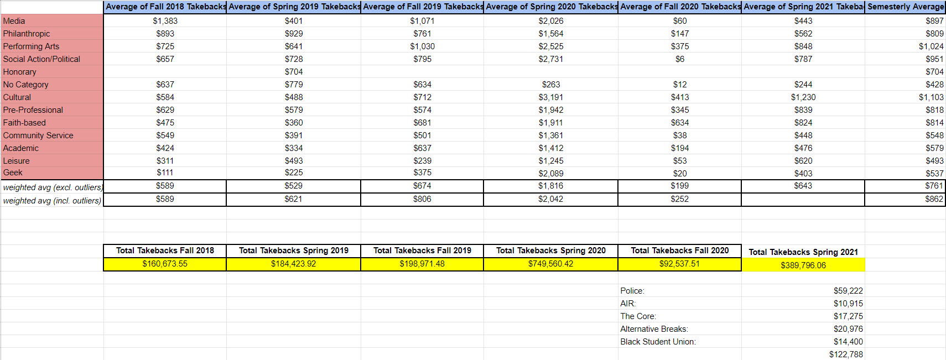
Fall 2020:
Sharp decline in takebacks, 69% lower than pre-pandemic levels.
Attributed much lower requests, along with no requests in costly categories such as room rental/food/equipment.
Spring 2021:
Big increase in the average takeback, in recovery of pandemic.
Lots of large account outliers that increased the averages and total takeback.
Takebacks without outliers = $267,008.06
Notes:
Kobi

Slide 5
Looking Back
Takeback research has been worked on in the past, however, has not resulted in much
Since the data is available solutions need to be implemented (see slide 8)
Strong correlation between auditing and takeback research
Notes:
Sanjana

Slide 6
Contact Clubs
Most Heard Feedback:
COVID changes / obstacles
Lack of understanding of the Budget Application
Speakers end up costing more than expected, cannot fully use funds
Inexperienced clubs / repeat clubs
Eboard complications
Lack of treasurer knowledge
Overestimated
Unsure of what final costs would be
Notes:
How we approached contacting clubs and why
Some previous feedback that we have and how this led to a on-going project with the questionnaire and intake form
Sanjana

Slide 7
Club Responses
KSA: We felt that there was too much complication within adjusting for a short period of time in the virtual environment. There was also a lack of advisor presence within the AACC throughout the pandemic that was difficult to navigate through.
Glee Club: Student org’s have never gotten what they initially requested, triggering a self-fulfilling prophecy of over-requesting. Further transparency on the method of funding is greatly desired to be able to properly request in terms of getting what they need.
Notes:
Kobi (KSA)
Allen (Glee Club)

Slide 8
Improvement
Related to Auditing History, if takebacks are high than they should be on the prioritized Auditing list and be resolved so it doesn’t continue into the future
Punishment for clubs with consistently high takebacks but mostly to rehabilitate and resolve the issue. We are not trying to burden future E-Boards for past mistakes.
Better for clubs and organizations to apply for the right amount or less and then come in for appeals if they need more (Transparency for appeals meetings)
Notes:
Anna
There are three key areas of improvement that we are planning for. Related to auditing history, if the takebacks of a certain club are high, then that club should be on the priortized auditing list. The club can be moved down the priority if such an issue does not exist in the future. Second area is having a punishment system for clubs with consistently high takebacks, not as a burden but as a way of bringing them back on track. And, lastly, to give clubs just the right amount of budgets or even less in certain situations (depending on the club standing). If the club needs more for the right reasons, they can most definitely come back in for appeals. This increases our core value of transparency within the appeals meetings.

Slide 9
Moving Forward
Questionnaire - Questionnaire Form
The purpose of this questionnaire is to gain information about spending and requesting habits, their experience with the Allocations Board (and SABO), and ways in which we can make their lives easier
Intake Form - Intake Form
Analyze logistics and in-depth data of funds usage
Focus on discrepancies
Intake Form contains specific tables for spending & reasoning
Important for record keeping for Allocations & Club E-Board
Notes:
Describe the questionnaire and intake form to see how it will help us and work throughout the year
Allen (questionnaire)
Anna (intake form) - attached above
The purpose of the Intake Form, designed last year, is to analyze more comprehensive data in what funds are not being used and why. This will also provide us with a detailed description of club funds and help us address areas of discrepancies, if any. There are tables for specific allocations amounts and the reasoning to these numbers. Lastly, the Intake Form would be a vital tool for us in terms of record-keeping for both the Allocations Board and the audited club’s E-Board. It helps for greater transparency in the auditing interaction between the Allocations Board and the respective club

Slide 10
General Report
Higher takebacks than previous semesters
High average in takebacks from completely cancelled events / speakers
The organization couldn’t fund most of their items or didn’t end up using it at all
Organizations have issues with budget application and struggles to adjust virtually with constant changes
Most organizations felt they were left to function alone without proper support
They think the budget application is too ambiguous
It is essential that we gather more detailed information on what we can do as a Board to better support and adjust our relationships to create less takebacks
Questionnaire and Intake form - An ongoing collection of data
Proper response and action taken
Notes:
Kobi

